Slide 1
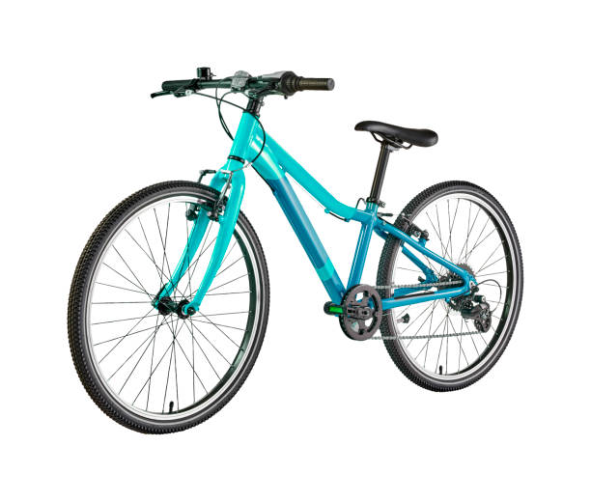
AHG
REPORT
Adventure Hardware Group
Bicycle And Accessories Sales

Slide 2
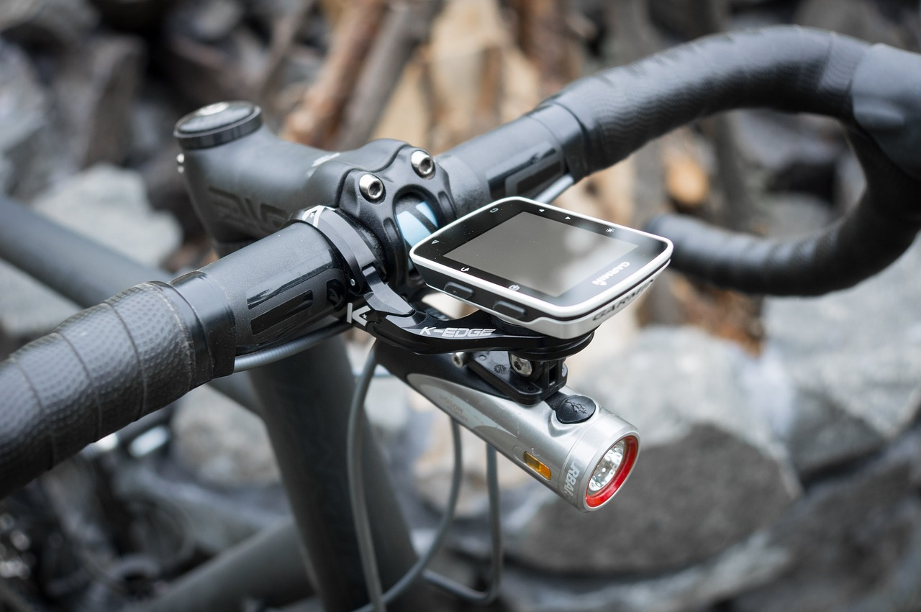
Executive Summary
Introduction
Methodology
Conclusions
Recommendations

Slide 3
Adventure Hardware Group
The Adventure Hardware Group is a global entity with a presence in North America, Europe, and Asia. AHG functions as a worldwide manufacturer and specialized online retailer, operating both as a direct seller and reseller of various bicycle-related products such as road bikes, mountain bikes, touring bikes, bicycle components, accessories, and apparel. Their core expertise lies in the categories of road, mountain, and touring bikes. As the leading online retailer in this industry, their commitment is to provide customers with a personalized experience that matches the level of service found in the best local stores. AHG's dynamic and interactive platform is meticulously designed to empower customers with knowledge and confidence in their extensive product offerings.

Slide 4
EXPLORING THE SHIFT IN THE MARKET PLACE TOWARD DIGITAL
Our initial priority will be to diligently observe and analyze the unfolding market shift. This critical phase sets the stage for our strategic approach. Subsequently, we will delve deeply into the multifaceted factors that could potentially shape this emerging landscape. This comprehensive exploration will serve as the compass guiding us towards the project's development, ensuring that we remain agile and adaptable in response to this evolving pattern. In essence, our journey commences with astute market observation, leading us through a refined exploration of pivotal influences, ultimately culminating in the blueprint for our project's success.

Slide 5
METHODOLOGY
Retrieve Data from Adventure Warehouse Database:
- Extract data from the Adventure Warehouse database.
2. Perfume Query in Microsoft SQL:
- Formulate an SQL query to extract the pertinent datasets related to perfumes.
3. Data Transformation with Power BI Query Editor:
- Utilize Power BI Query Editor to clean and reshape the data as needed.
4. Establishing Data Model and Relationships:
- Create a structured data model and define relationships between relevant data
5. Visualize Data and Gain Insights:
- Generate visualizations and extract valuable insights from the processed data.
Basket analysis to improve revenue
- Select relevant dataset for basket analysis
Forecasting into futures sales
- Using Machine Learning Time Series analysis

Slide 6
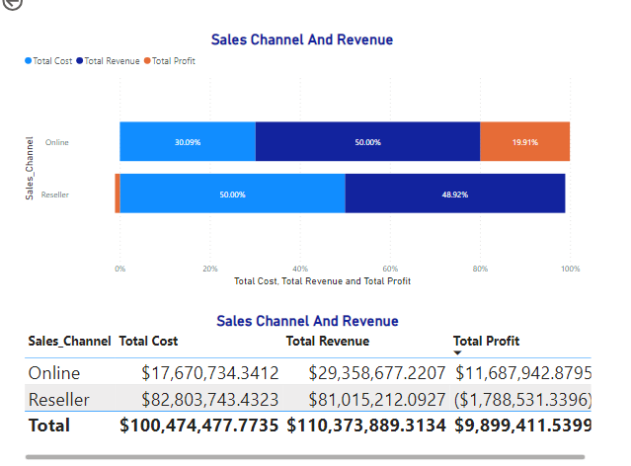
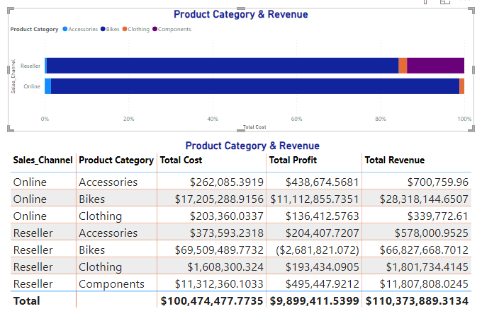
AHG FINANCIAL SUMMARY & REVENUE COMPARISM
Total Cost and Total Revenue exhibit a positive correlation. Reseller's share of the Total_Cost amounted to 82.41%. For Online, the figures were as follows: Total Cost $17,670,734.3412, Total Revenue $29,358,677.2207, and Total Profit $11,687,942.8795. On the other hand, Reseller had Total Cost of $82,803,743.4323, Total Revenue of $81,015,212.0927, and a Total Profit of ($1,788,531.3396).
﻿Bikes had the highest total Total_Cost at $86,714,778.6888, followed by Clothing at 1,811,660.36 and Accessories at 635,678.62.﻿ ﻿﻿Reseller in Product Category Bikes made up 69.18% of Total Cost.﻿﻿ Bikes had the highest average Total Cost at 43,357,389.34, followed by Clothing at 905,830.18 and Accessories at 317,839.31.﻿﻿

Slide 7
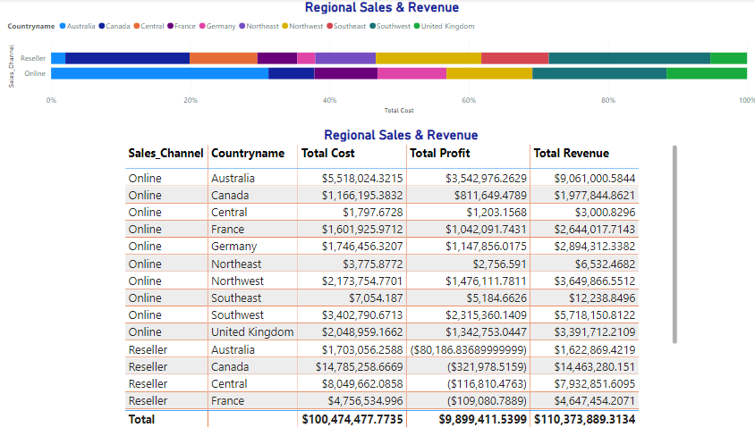
Reseller in Southwest made up 19.13 of the Total Cost
FINANCIAAL SUMMARY & COUNTRY REGION

Slide 8
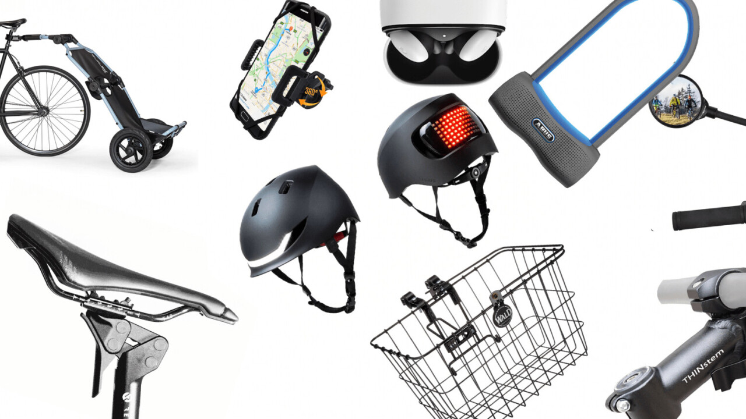
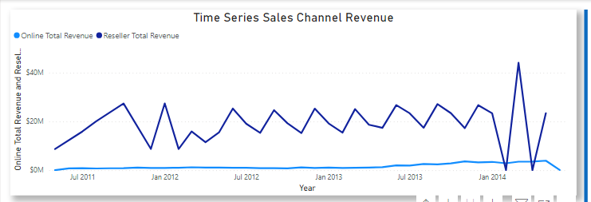
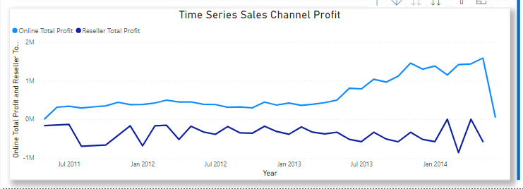
MARKET SHIFT TOWARD DIGITAL
﻿Reseller Total Revenue (168.72% increase) and Online Total Revenue (332.52% increase) both trended up between May 2011 and June 2014. Online Total Revenue started trending up on March 2013, rising by 135.05% (1,369,656.45) in 6 months.﻿ Online Total Revenue jumped from 1,014,183.58 to 2,383,840.03 during its steepest incline between March 2013 and September 2013.﻿﻿
﻿Online Total Profit trended up (474.13% increase) while Reseller Total Profit (250.07% decrease) trended down between May 2011 and June 2014.﻿﻿ Reseller Total Profit started trending down on April 2013, falling by 37.55% (142,099.40) in 8 months.﻿﻿ Online Total Profit jumped from 390,421.61 to 963,830.54 during its steepest incline between March 2013 and September 2013.﻿﻿﻿

Slide 9
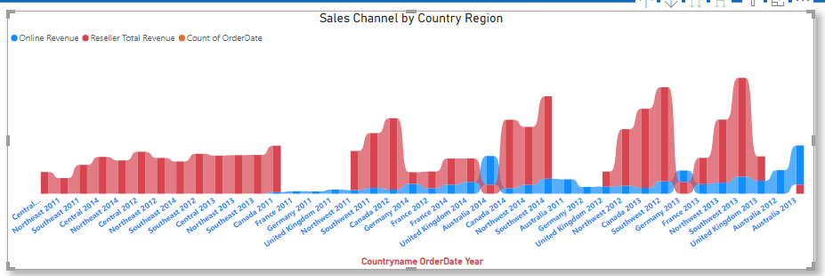
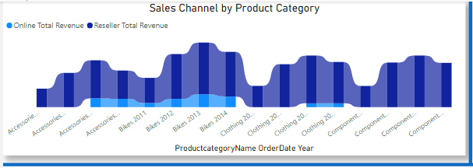
MARKET SHIFT TOWARD DIGITAL Country Regions
﻿2013 had the highest total Online Revenue at $19,055,021.06, followed by 2014, 2012, and 2011.﻿ ﻿Australia in Year 2013 made up 13.12% of Online Revenue.﻿﻿ ﻿﻿2013 had the highest average Online Revenue at 1,905,502.11, followed by 2014, 2012, and 2011.﻿
MARKET SHIFT TOWARD DIGITAL Product Category
﻿Total Online Total Revenue was higher for 2013 ($37,031,188.9733) than 2014 (33,149,291.24).﻿ Online Total Revenue and total Reseller Total Revenue are positively correlated with each other.﻿﻿ ﻿﻿Bikes in Year 2013 made up 21.13% of Online Total Revenue.﻿﻿ ﻿﻿Average Online Total Revenue was higher for 2013 (12,343,729.66) than 2014 (11,049,763.75).﻿

Slide 10
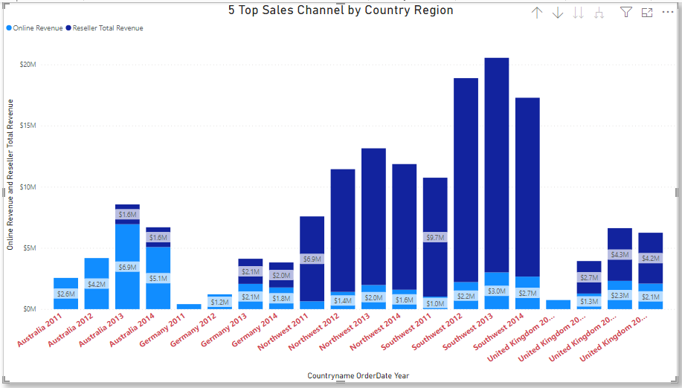
MARKET SHIFT TOWARD DIGITAL Country Regions
﻿2013 had the highest total Online Revenue at $16,293,377.96, followed by 2014, 2012, and 2011.﻿﻿ ﻿﻿Australia in Year 2013 made up 15.38% of Online Revenue.﻿﻿ 2013 had the highest average Online Revenue at 3,258,675.59, followed by 2014, 2012, and 2011.﻿﻿

Slide 11
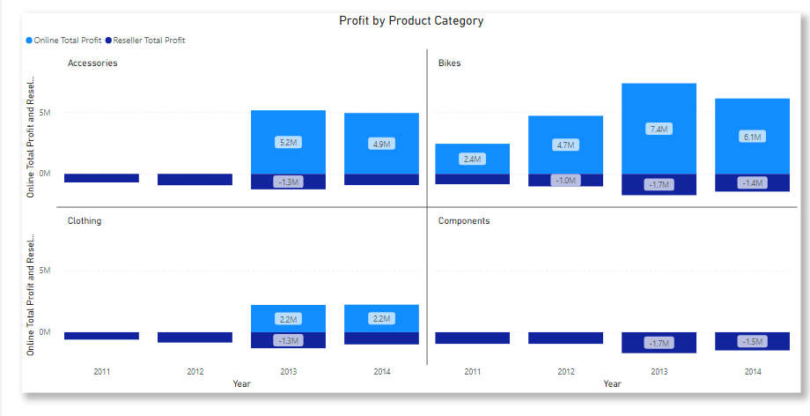
MARKET SHIFT TOWARD DIGITAL Product Category
﻿﻿﻿Total Online Total Profit was higher for 2013 (14,738,816.51) than 2014 (13,308,760.15).﻿﻿ Online Total Profit and total Reseller Total Profit are negatively correlated with each other.﻿﻿ Bikes in Year 2013 made up 20.89% of Online Total Profit.﻿﻿ Average Online Total Profit was higher for 2013 (4,912,938.84) than 2014 (4,436,253.38).﻿﻿

Slide 12
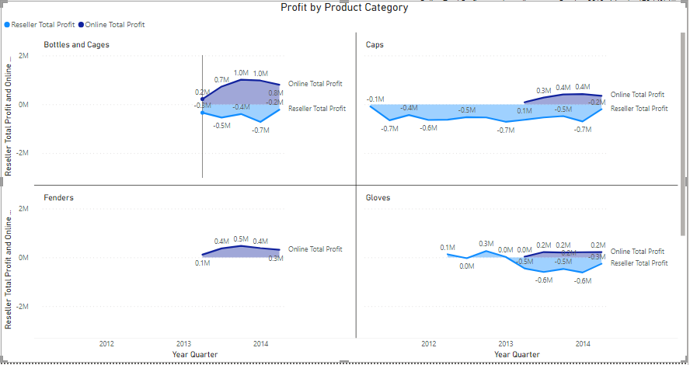
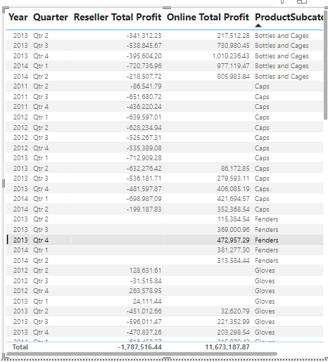
IN PHASE OF MARKET SHIFT IS BUSINESS MAKING PROFIT
﻿﻿﻿﻿Online Total Profit trended up (826.68% increase) while Reseller Total Profit (250.07% decrease) trended down between April 2011 and April 2014.﻿﻿
﻿Online Total Profit started trending up on October 2012, rising by 170.14% (1,887,505.02) in 6 quarters.﻿﻿ Online Total Profit jumped from 1,109,377.91 to 2,996,882.93 during its steepest incline between October 2012 and April 2014.﻿﻿

Slide 13
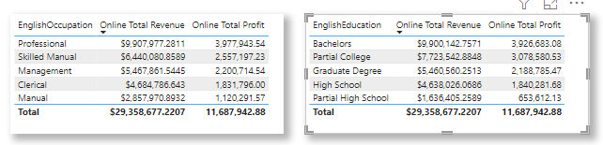
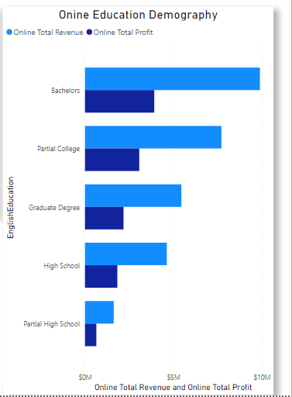
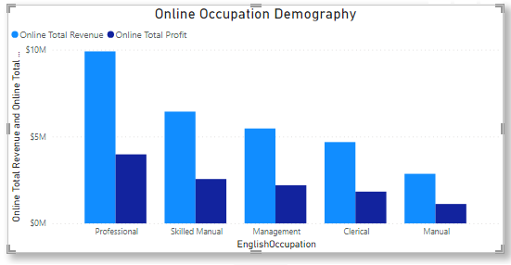
ONLINE DEMOGRAPHY: OCCUPATION & EDUCATION
﻿At $9,900,142.7571, Bachelors had the highest Online Total Revenue and was 504.99% higher than Partial High School, which had the lowest Online Total Revenue at $1,636,405.2589.﻿﻿ Online Total Revenue and total Online Total Profit are positively correlated with each other.﻿﻿ Bachelors accounted for 33.72% of Online Total Revenue.﻿﻿ Online Total Revenue and Online Total Profit diverged the most when the English Education was Bachelors, when Online Total Revenue were $5,973,459.6821 higher than Online Total Profit.﻿﻿
﻿At $9,907,977.2811, Professional had the highest Online Total Revenue and was 246.68% higher than Manual, which had the lowest Online Total Revenue at $2,857,970.8932.﻿﻿ Online Total Revenue and total Online Total Profit are positively correlated with each other.﻿﻿ Professional accounted for 33.75% of Online Total Revenue.﻿﻿ Online Total Revenue and Online Total Profit diverged the most when the English Occupation was Professional, when Online Total Revenue were $5,930,033.741799998 higher than Online Total Profit.﻿

Slide 14
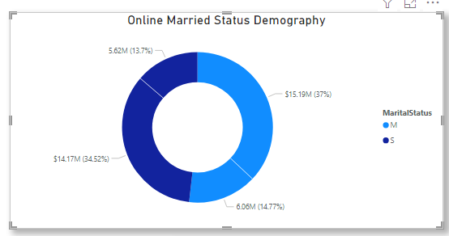
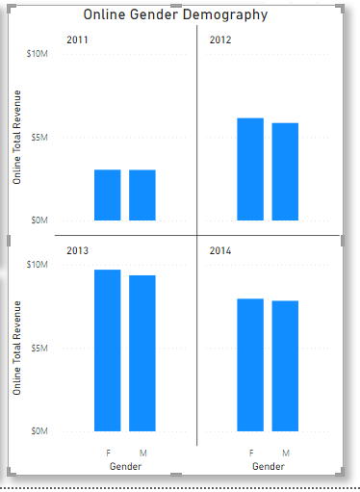
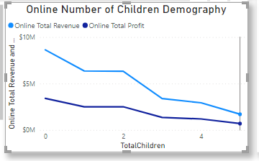
ONLINE DEMOGRAPHY: Gender, Marital Status
﻿MARRIED STATUS
M accounted for 51.73% of Online Total Revenue.﻿﻿ Online Total Revenue and Online Total Profit diverged the most when the Marital Status was M, when Online Total Revenue were $9,123,683.55910004 higher than Online Total Profit.﻿﻿
GENDER DEMOGRAPH
﻿F accounted for 50.46% of Online Total Revenue.﻿﻿ ﻿﻿Online Total Revenue and Online Total Profit diverged the most when the Gender was F, when Online Total Revenue were $8,913,090.354700033 higher than Online Total Profit.﻿﻿
﻿CHILDREN DEMOGRAPHY
At $8,634,026.9381, 0 had the highest Online Total Revenue and was 405.66% higher than 5, which had the lowest Online Total Revenue at $1,707,470.3382.﻿﻿ ﻿﻿Online Total Revenue and total Online Total Profit are positively correlated with each other.﻿﻿ 0 accounted for 29.41% of Online Total Revenue.﻿﻿ Online Total Revenue and Online Total Profit diverged the most when the Total Children was 0, when Online Total Revenue were $5,217,973.115000003 higher than Online Total Profit.﻿﻿

Slide 15

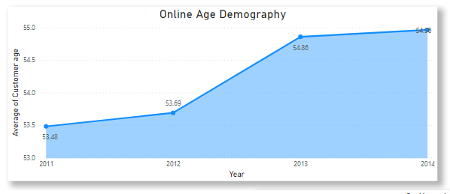
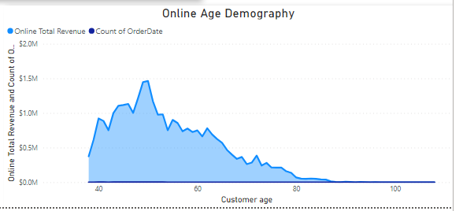
AGE DEMOGRAPHY
﻿﻿CUSTOMER AVERAGE AGE
Average of Customer age trended up, resulting in a 2.77% increase between 2011 and 2014.﻿﻿ Average of Customer age started trending up on 2011, rising by 2.77% (1.48) in 3 years.﻿﻿ Average of Customer age jumped from 53.48 to 54.96 during its steepest incline between 2011 and 2014.﻿
﻿At $1,464,270.8629, 50 had the highest Online Total Revenue and was 2,193,564.21% higher than 101, which had the lowest Online Total Revenue at $66.75.﻿﻿ Online Total Revenue and total Count of Order Date are positively correlated with each other.﻿﻿ 50 accounted for 4.99% of Online Total Revenue.﻿﻿ Online Total Revenue and Count of Order Date diverged the most when the Customer age was 50, when Online Total Revenue were $1,463,707.8629 higher than Count of Order Date.﻿﻿

Slide 16
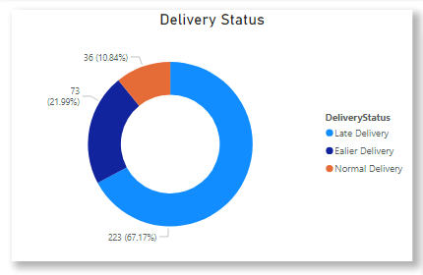
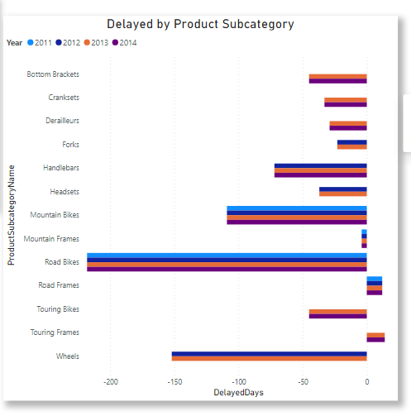
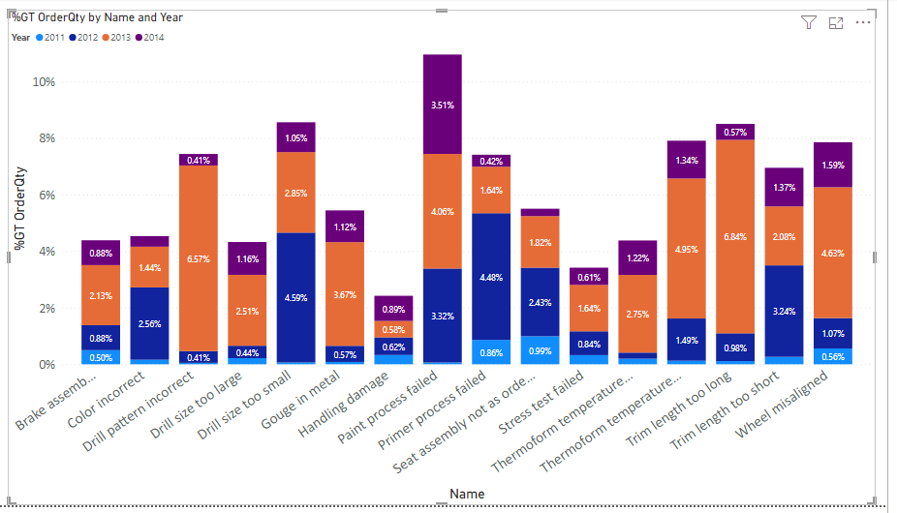
DELIVERY STATUS
﻿Late Delivery had the highest Count of Delivery Status at 223, followed by Earlier Delivery at 73 and Normal Delivery at 36.﻿﻿ Late Delivery accounted for 67.17% of Count of Delivery Status.﻿﻿
﻿PRODUCTS DELAY
﻿2011 had the highest total Delayed Days at -319, followed by 2014, 2012, and 2013.﻿﻿ 2014 had the highest average Delayed Days at -52.90, followed by 2013, 2012, and 2011.﻿﻿
AREA AHG SHOULD IMPROVE

Slide 17
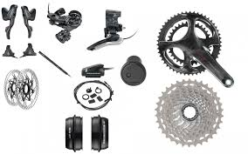
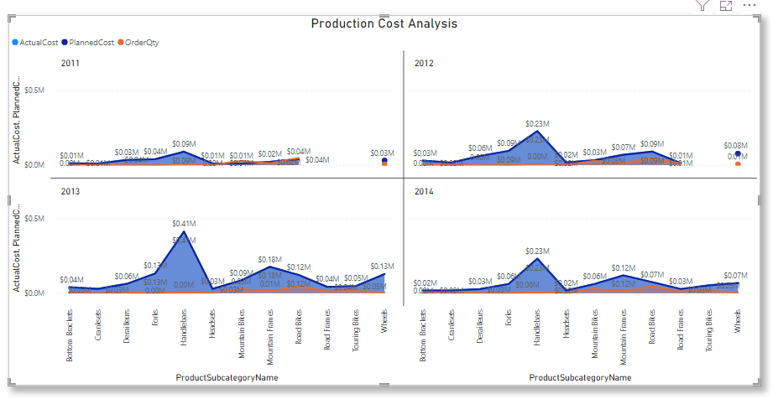
PRODUCTION COST
﻿﻿At $959,744.5, Handlebars had the highest Actual Cost and was 1,200.57% higher than Cranksets, which had the lowest Actual Cost at $73,794.﻿﻿
﻿﻿Actual Cost and total Planned Cost are positively correlated with each other.﻿﻿ Handlebars accounted for 30.98% of Actual Cost.﻿﻿ Across all 35 Product Subcategory, Actual Cost ranged from $73,794 to $959,744.5, Planned Cost ranged from $73,794 to $959,744.5, and Order Quantity ranged from 249 to 47196.﻿﻿
AREA AHG SHOULD IMPROVE

Slide 18
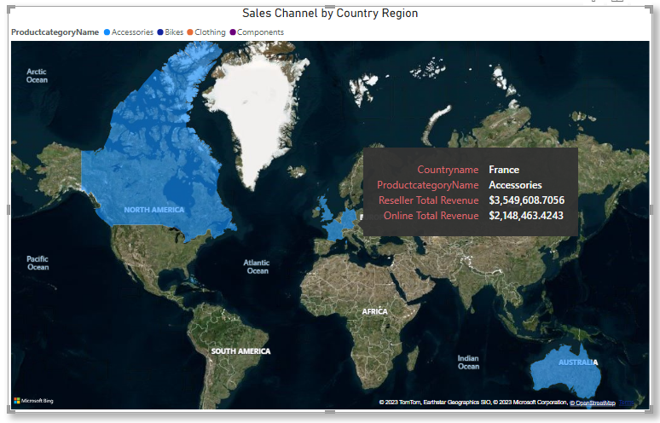
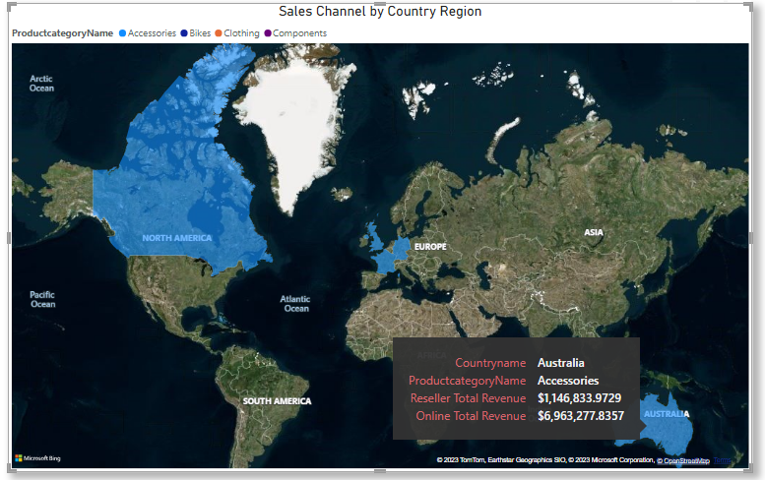
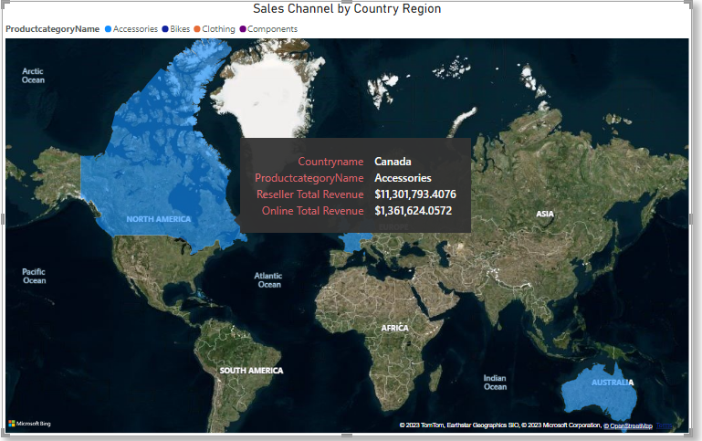
MARKET SHARE
﻿
Market Share
﻿Bikes had the highest total Online Total Revenue at $28,726,182.0807, followed by Accessories at 22,466,598.72 and Clothing at 10,807,209.63.﻿﻿ Australia in Product category made up 14.44% of Online Total Revenue.﻿﻿
﻿﻿﻿﻿Bikes had the highest average Online Total Revenue at 2,872,618.21, followed by Accessories at 2,246,659.87 and Clothing at 1,080,720.96.﻿﻿

Slide 19
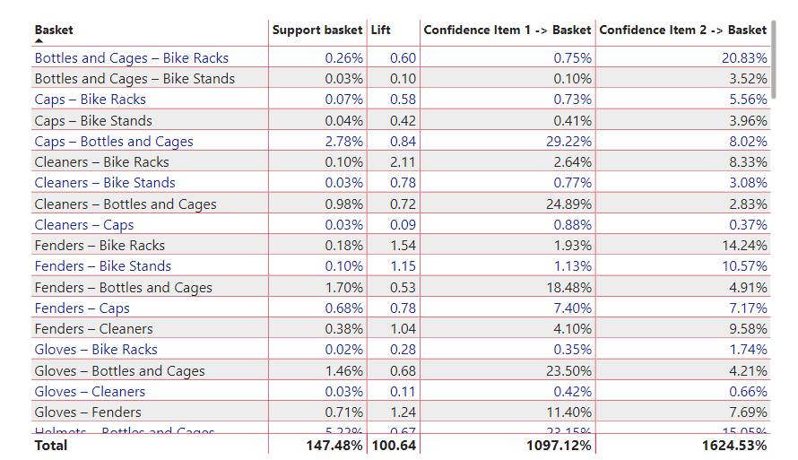
BASKET ANALYSIS

Slide 20
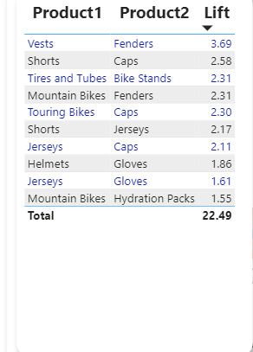
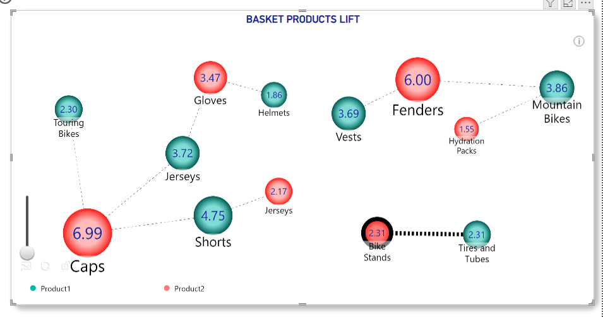
BASKET ANALYSIS PRODUCTS LIFT

Slide 21
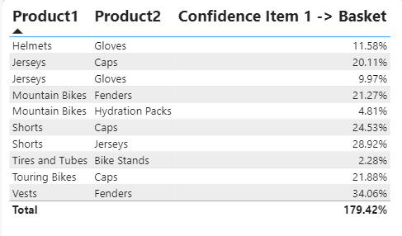
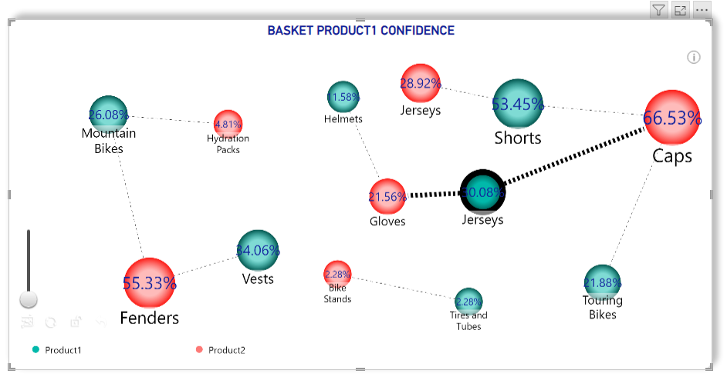
BASKET ANALYSIS PRODUCTS CONFIDENCE1

Slide 22
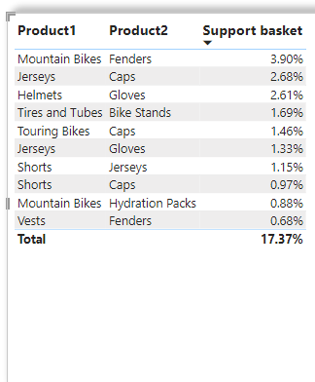
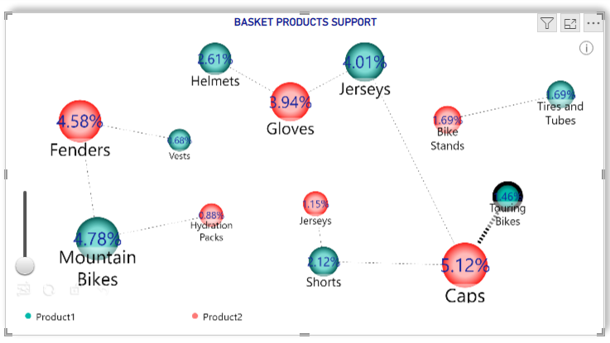
BASKET ANALYSIS PRODUCTS CONFIDENCE2

Slide 23
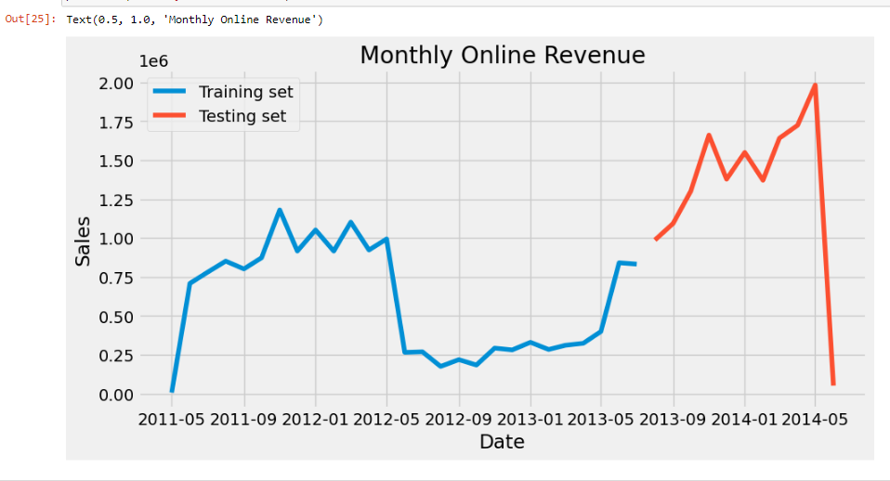
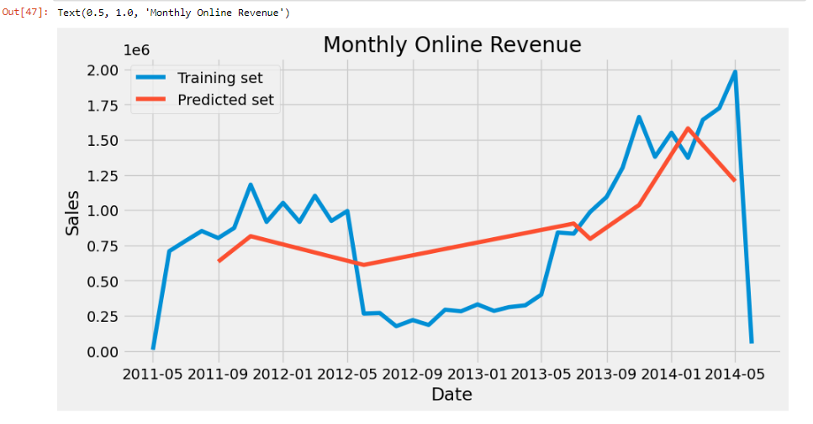
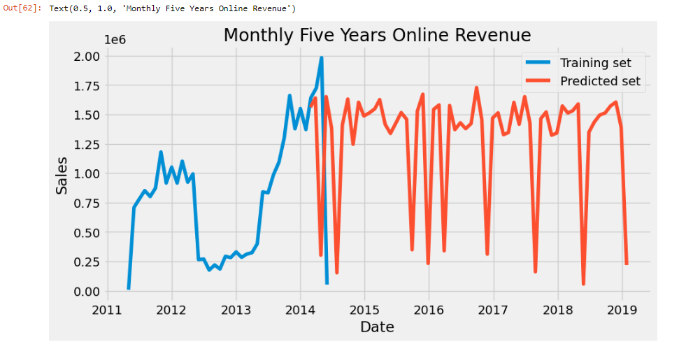
MONTHLY FIVE YEARS FORECASTING
﻿
Market Share
﻿Bikes had the highest total Online Total Revenue at $28,726,182.0807, followed by Accessories at 22,466,598.72 and Clothing at 10,807,209.63.﻿﻿ Australia in Product category made up 14.44% of Online Total Revenue.﻿﻿
﻿﻿﻿﻿Bikes had the highest average Online Total Revenue at 2,872,618.21, followed by Accessories at 2,246,659.87 and Clothing at 1,080,720.96.﻿﻿

Slide 24
Conclusions:
In conclusion, our financial summary review some key insights. Firstly, resellers contributed significantly to the total cost, representing a substantial 82.41% of the overall expenditure. Unfortunately, the profit for this period amounted to -$1,788,531.3396, indicating a loss. Additionally, it's worth note that Bike had the highest total cost and generated the highest total profit for online while reseller incurred lost of -$2,681,821.072 on bike sales

Slide 25
Regional Revenue
Examining regional revenue distribution, Australia stands out as a notable case. Australia experienced a reseller loss of approximately -80,186,833, signaling a challenging market in this region. In contrast, the online business segment displayed promising results, steadily increasing its profit while resellers faced declining figures. Specifically, reseller revenue showed a remarkable increase of 168%, while online revenue witnessed an impressive growth rate of 322%. The profit contrast is equally striking, with online sales boasting a remarkable 474.13% increase, while resellers encountered a substantial 250.07% decrease.

Slide 26
Sales Channel by Country
Diving deeper into the data, it's essential to highlight the sales channel by country. In this context, Australia played a significant role, contributing 13.12% of the online revenue. Interestingly, 2013 saw the highest online average revenue, with Bike accounting for 21.13% of the online revenue during that year

Slide 27
Online Demographics
Lastly, a breakdown of online demographics uncovers essential trends. Bachelor-degree holders emerged as the most lucrative customer segment, generating a remarkable 504.99% higher online revenue compared to those with a partial high school education. Similarly, professionals stood out, enjoying a 246.68% higher online revenue than individuals with a manual occupation. Furthermore, customers with no children recorded the highest online revenue, and gender-wise, females contributed significantly, accounting for 50.46% of the total online revenue. The married segment proved substantial, contributing 51.73% of the online revenue. In summary, our comprehensive analysis reveals important insights into the financial performance, regional variations, sales channels, and demographics of our business operations, providing a valuable foundation for strategic decision-making moving forward.

Slide 28
Recommendations
To enhance AHG's revenue and boost sales, we suggest closely monitoring the delivery status since late deliveries accounted for a significant 67.17%, which is detrimental to the business. Additionally, it's crucial to examine the product manufacturing time, as we noticed a significant delay of approximately 319 days in 2011.The visualization dashboard also highlights a substantial amount of scrap generated for various reasons, which needs to be addressed promptly to optimize revenue. In conclusion, we recommend that the reseller store reduces operational costs to prevent future losses. Furthermore, a deliberate focus on online stores can significantly improve overall performance.

Slide 29
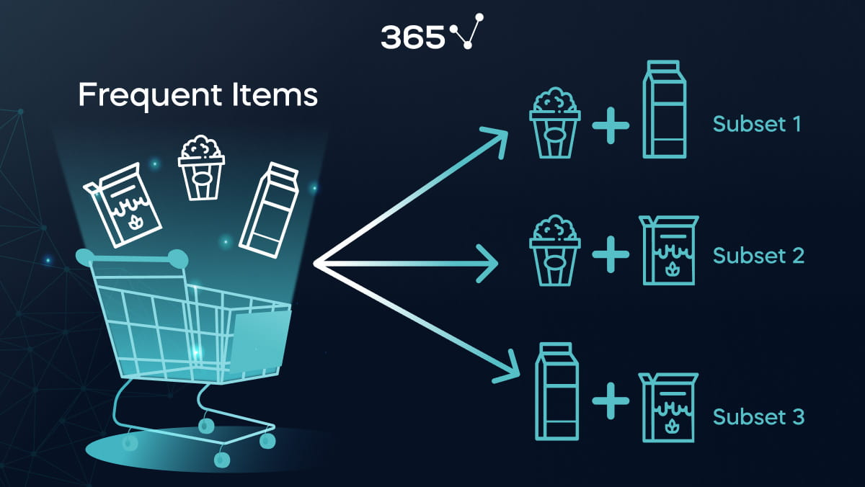
Recommendations
Awareness of basket analysis reveals products frequently purchased together by consumers and knowledge of this help in enhancing the revenue. In light of this, we highly recommend pairing mountain bikes with fenders, matching caps with jerseys, and helmets with gloves.
Moreover, we've observed a significant association between vests and fenders (with a lift of 3.69), shorts and caps (with a lift of 2.58), as well as mountain bikes and caps, and lot more as listed in basket lift table above. These associations are not mere coincidences, indicating a strong relationship for pairing these items together.

